Slide 1
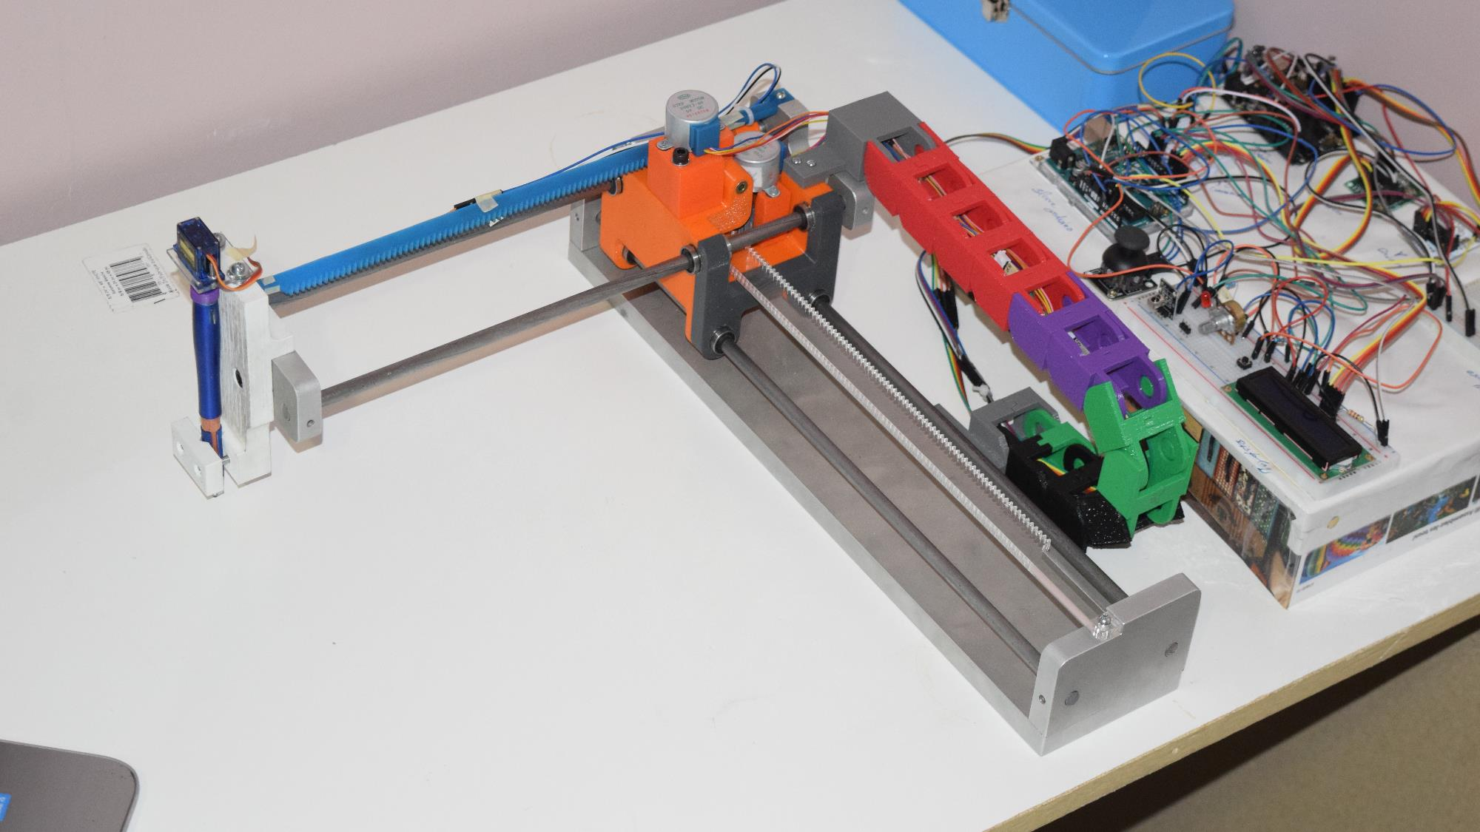
cnc plotter
CADD24328 - Catia term Project
Presented by: Sandeep singh – 991490328 Professor: Fereydoon diba

Slide 2
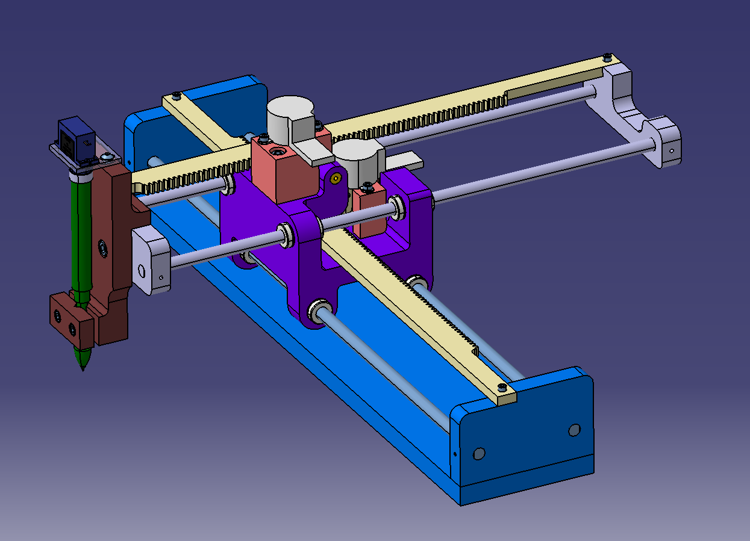
introduction
Project designed and modeled in CATIA.
CNC Plotter - A handy machine to draw.
Controlled by CNC programs generated by Mastercam.
Arduino based actuators controlled.
Easy to manufacture and replaceable parts.
X, Y and Z Motors to draw on Letter size paper.
Fine level of details in point of manufacturing and assembly

Slide 3
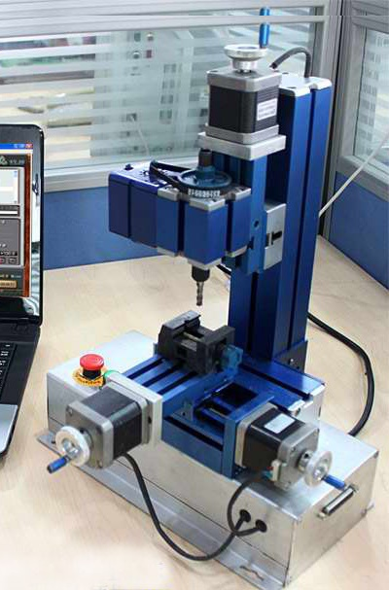
Inspiration
Combination of mechanical and electrical spheres – as a small robot.
Creative and useable at some point
Project- based learning in fields of 3D modeling, drafting, simulation, advanced manufacturing processed and programming.
Medium scale projects helps building up strong base for large projects.

Slide 4
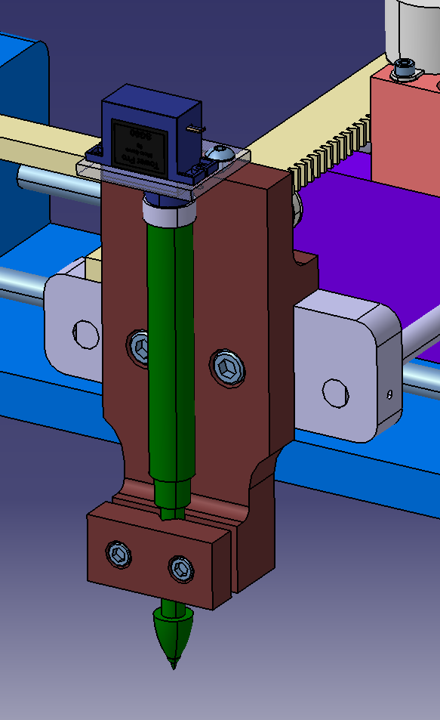
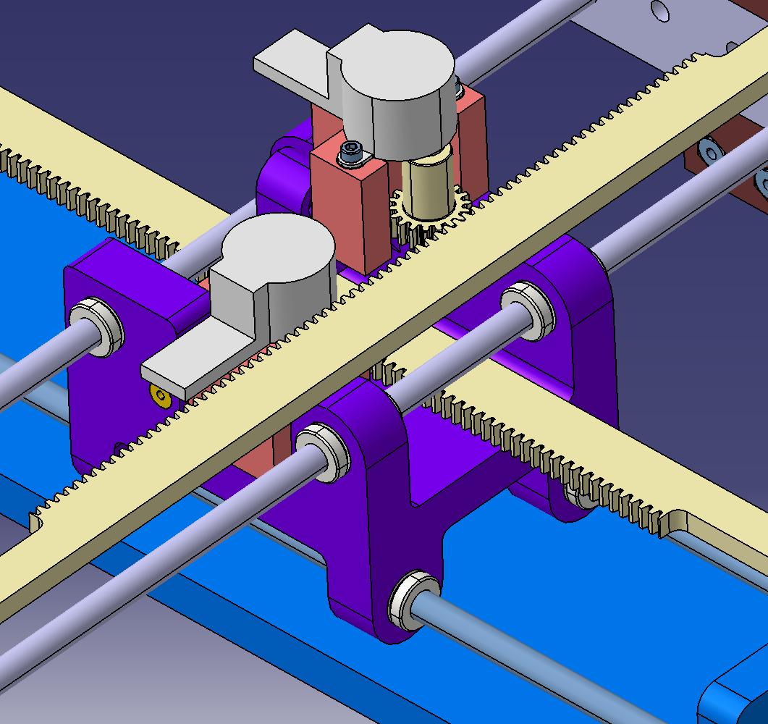
Main parts
Servo motor
4 Phase 5V Stepper Motors
Racks and pinions
Linear Bearings
Pen Holder and Assembly
Slider Block

Slide 5
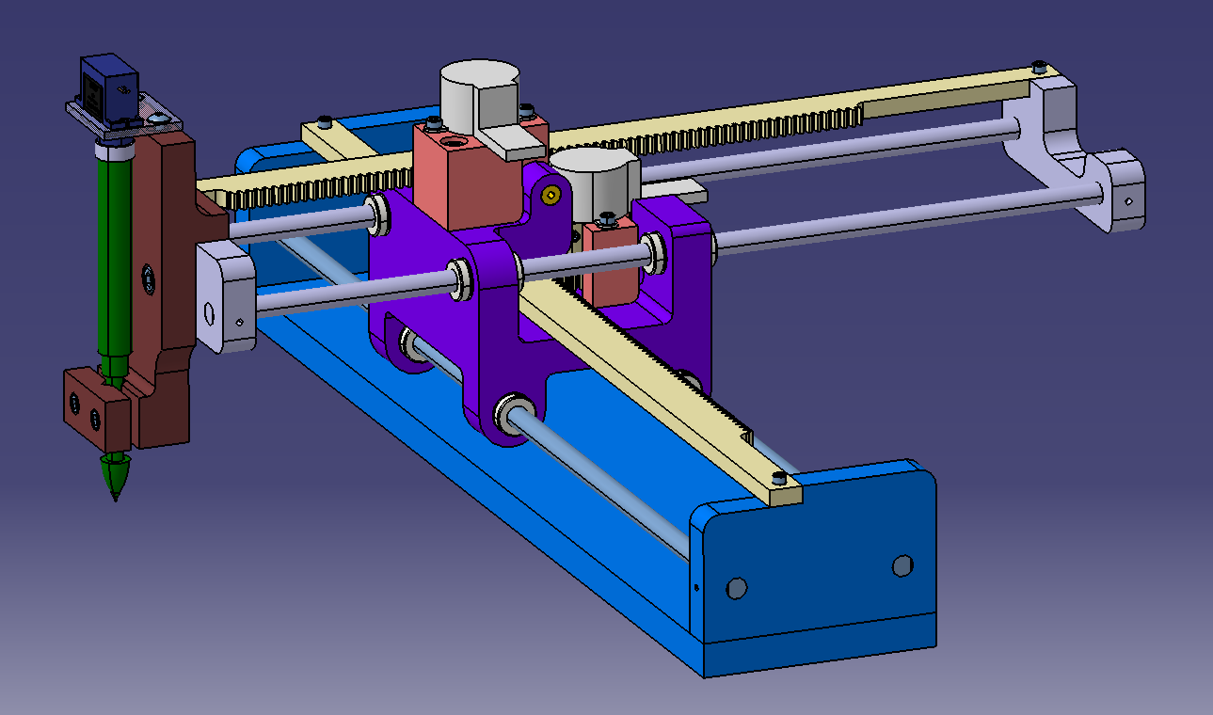
Assembly process
CNC-Plotter
X-Axis Assembly
Y-Axis Assembly
Pen holder Assembly
Servo motor and holder
Y-Axis rack and rods
Pen and Pen holder
X-Axis Rack and rods
Base
Pinions
Electrical Module
Slider block
Bearings
Threaded inserts
Stepper Motors Assembly
Stepper Motors
Motor holders and bushings

Slide 6
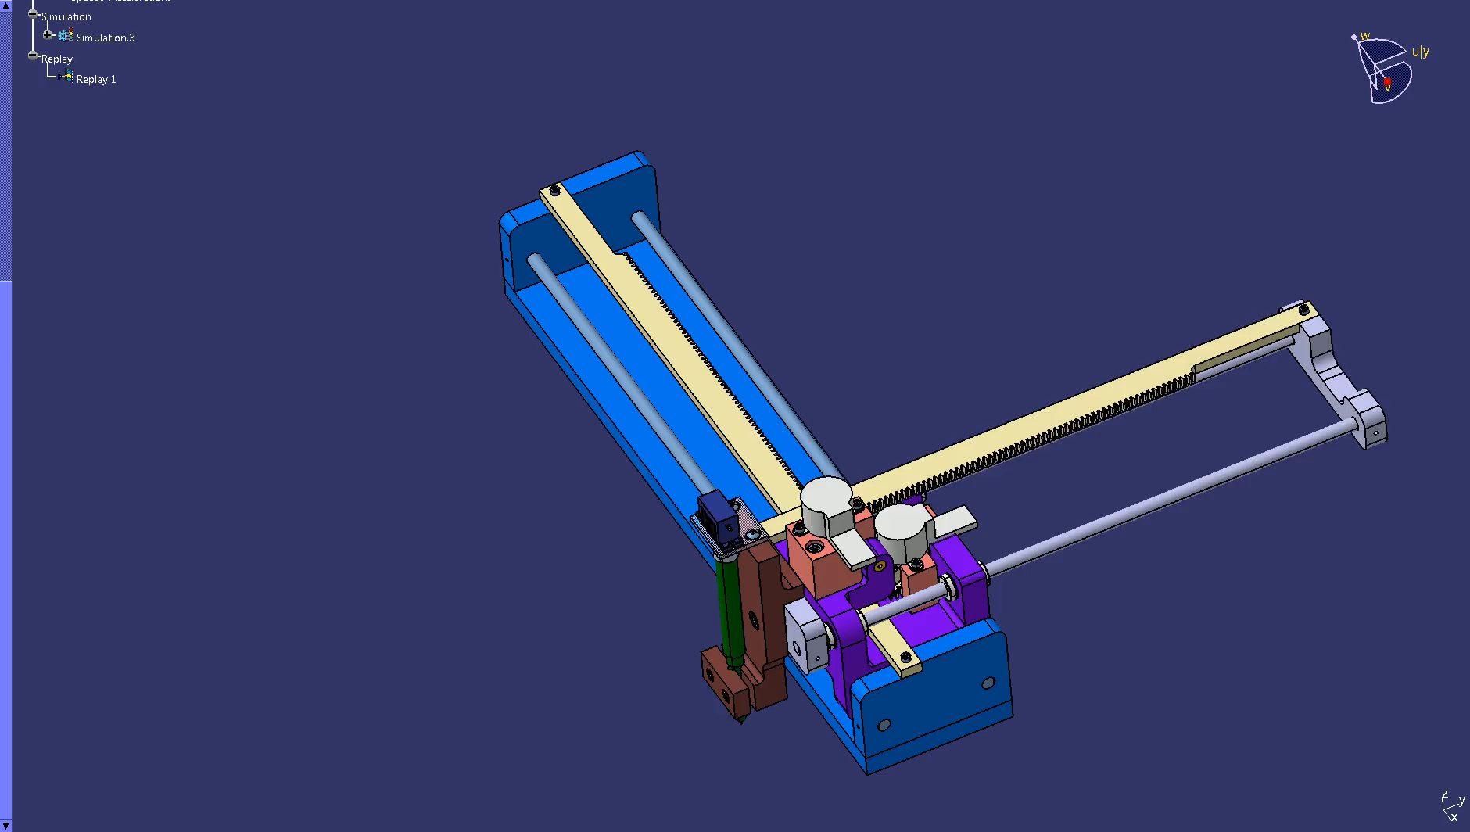
Simulation

Slide 7
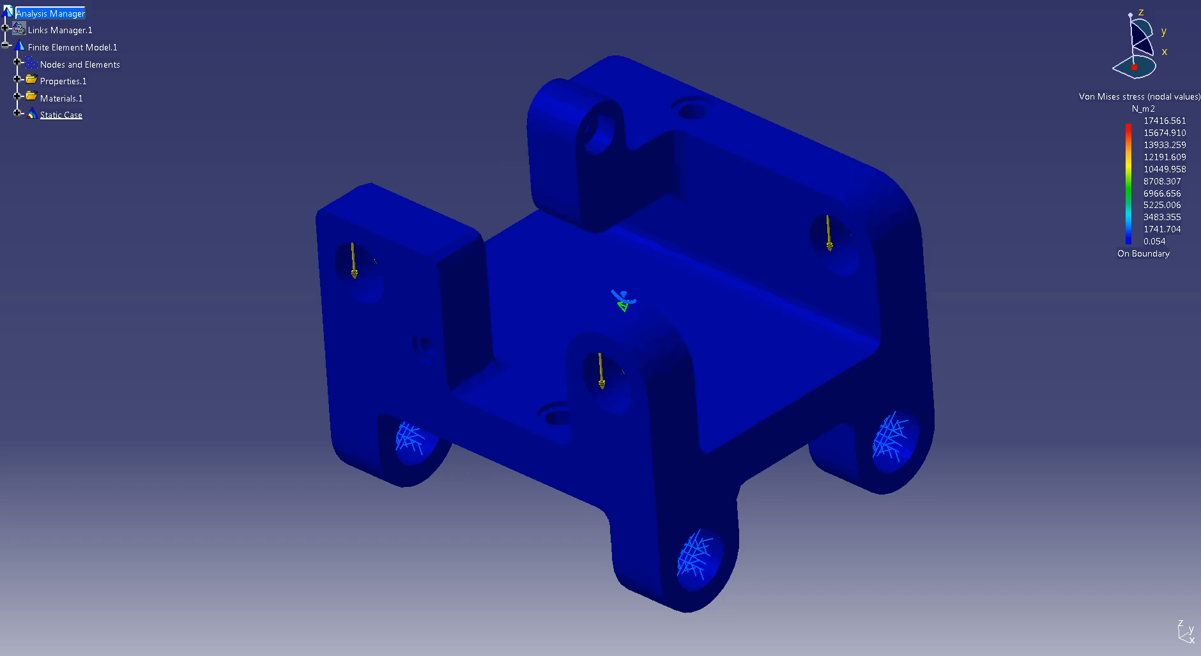
Fea stress analysis of slider block
Report Link

Slide 8
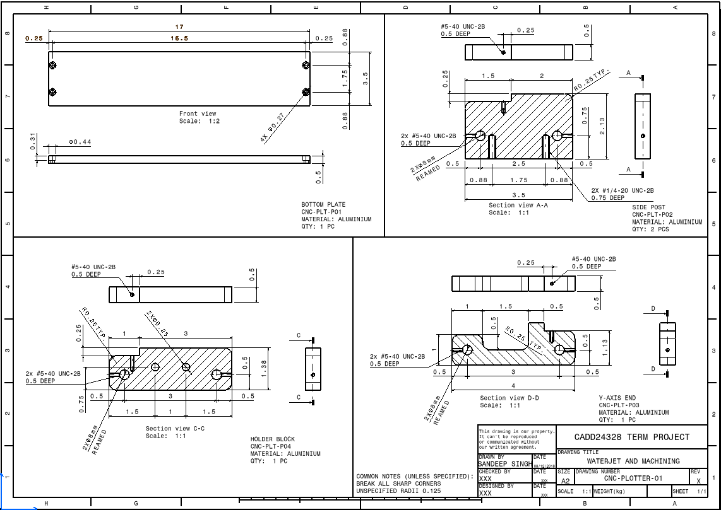
Detailed drawings
Detail drawings donated as “CNC-PLOTTER-xx”
Detailed parts donated as “CNC-PLT-Pxx”
Different drawings according to manufacturing processes – Waterjet, Laser Cutting, and 3D printing

Slide 9
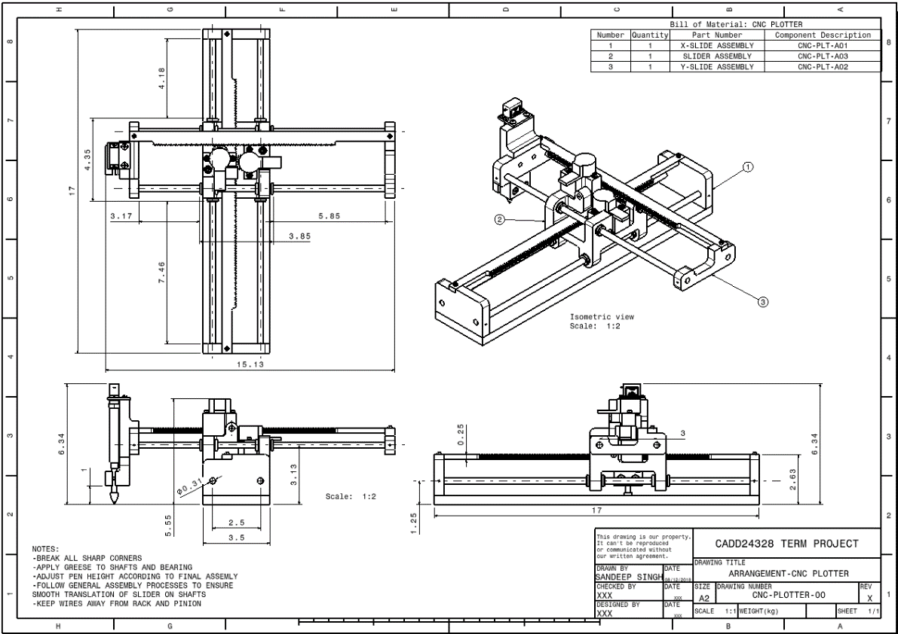
ASSEMBLY drawing
Assemblies donated as “CNC-PLOTTER-Axx”
Separate drawings for Sub- Assemblies
Bill of materials contains part numbers
Notes for specific assembly instructions

Slide 10
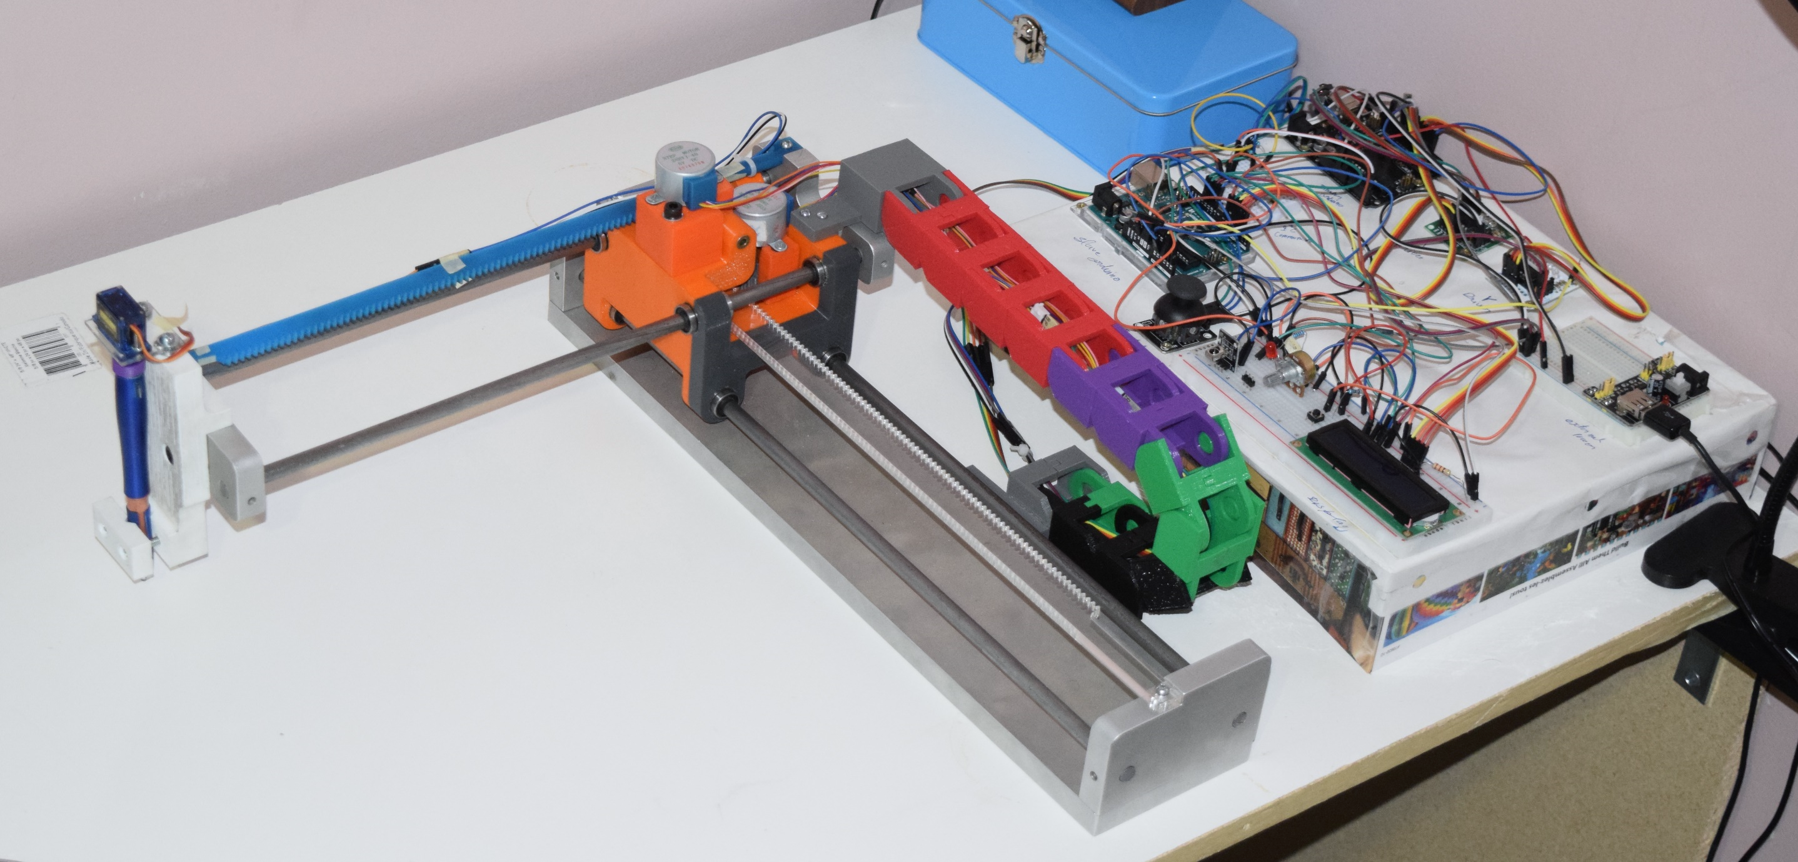
Thank you
Please feel free to ask questions
Manufacturing of the project was a team work, and I am very thankful to all who helped and motivated me all along the progress.

